Slide 1


Let’s talk about Higher Education
Notes:
[[Picture taken from https://www.flickr.com/photos/jenumfamily/14319331092 on 3/5/2016 6:39:06 PM]]

Slide 2
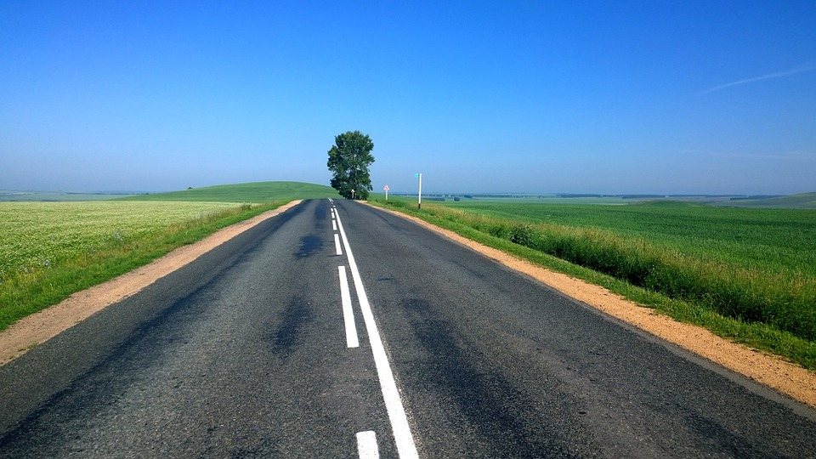

Learning is a never-ending journey.
Notes:
[[Picture taken from https://pixabay.com/en/photos/road trip/ on 3/5/2016 8:03:58 PM]]

Slide 3
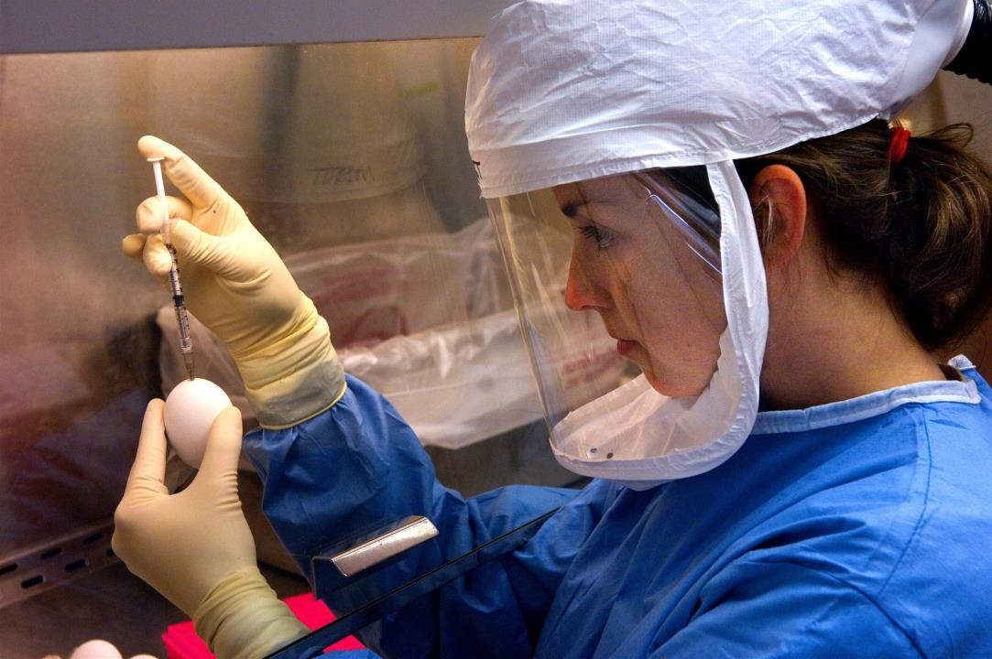
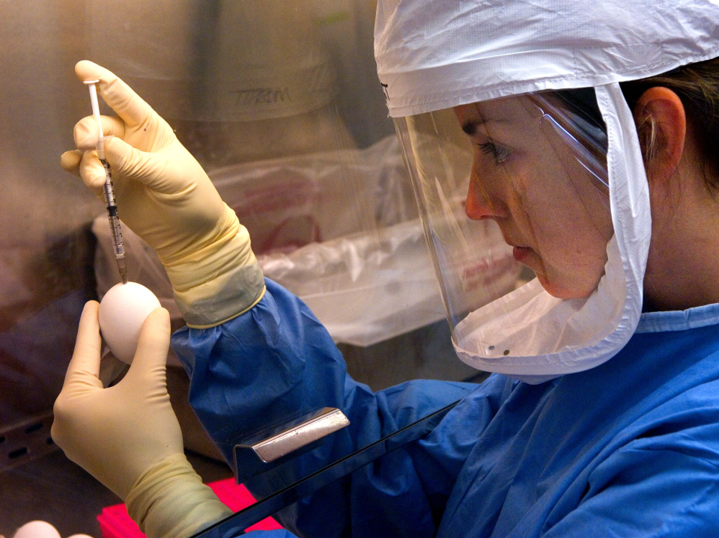
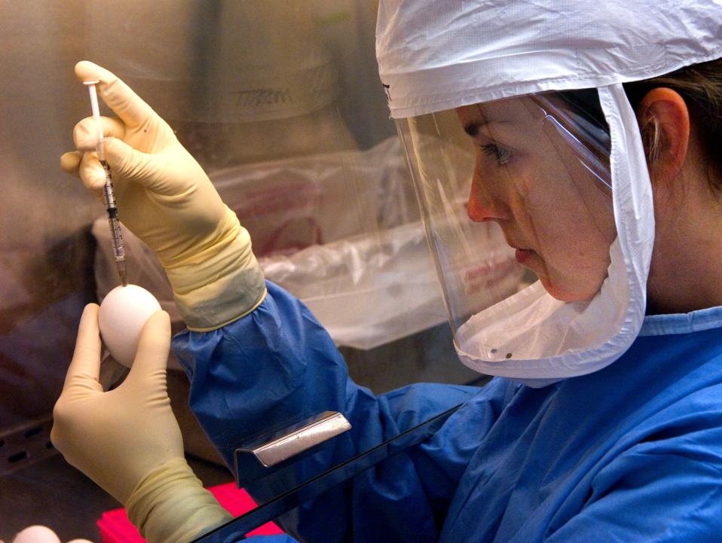
Discovering new knowledge is a big part of higher education.
Notes:
[[Picture taken from http://www.public-domain-image.com/free-images/science/biology-pictures/microbiologist-in-the-influenza-branch-while-she-was-conducting-an-experiment-inside-a-biological-safety-cabinet/attachment/microbiologist-in-the-influenza-branch-while-she-was-conducting-an-experiment-inside-a-biological-safety-cabinet on 3/5/2016 7:14:25 PM]]

Slide 4



Expect hardships.
Notes:
[[Picture taken from https://en.wikipedia.org/wiki/Rock_climbing on 3/16/2016 9:18:27 PM]]

Slide 5



You can use your knowledge to change the world.
Notes:
[[Picture taken from https://pixabay.com/en/technology-informatics-computers-298256/ on 3/5/2016 8:16:25 PM]]

Slide 6




It’s time for your future to take off!
Notes:
[[Picture taken from https://www.youtube.com/watch?v=uzMIWcyXEyU on 3/5/2016 8:11:40 PM]]

